Slide 1
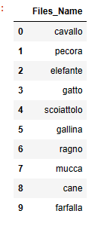
CNN Classification on detect animals
_This model explains CNN "Convolutional Neural Network“ ،this is a classification model foe detect the animal images.
_We use “MobileNetV3Small.” is a image classification. These networks are suitable for mobile and devices to r reduced the complexity
We have ten labels for ten kinds of animals

Slide 2
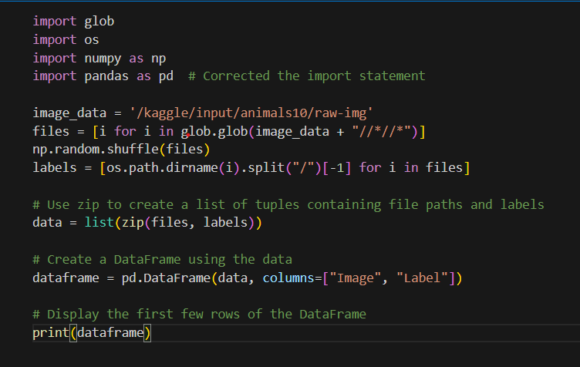
This code is designed to create a DataFrame from image files in the specified directory
(/kaggle/input/animals10/raw-img).

Slide 3
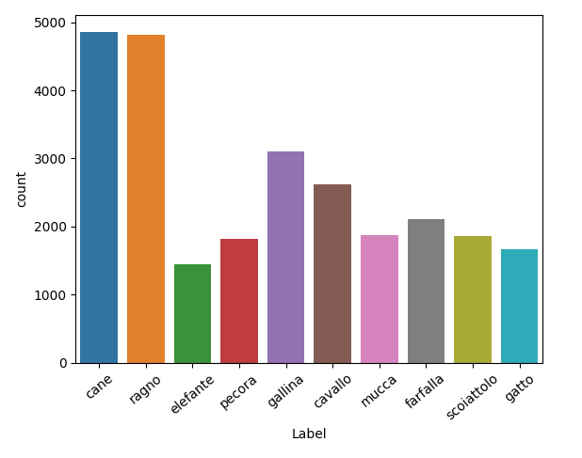
Visualization
this Visualization is defined the relationship between
numbers of images in every label.

Slide 4
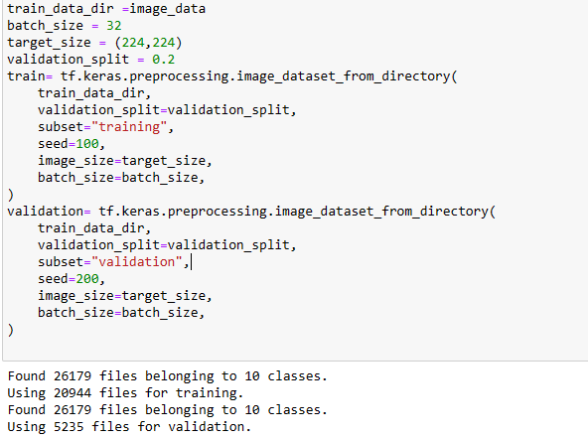
Split Train and Test Dataset

Slide 5
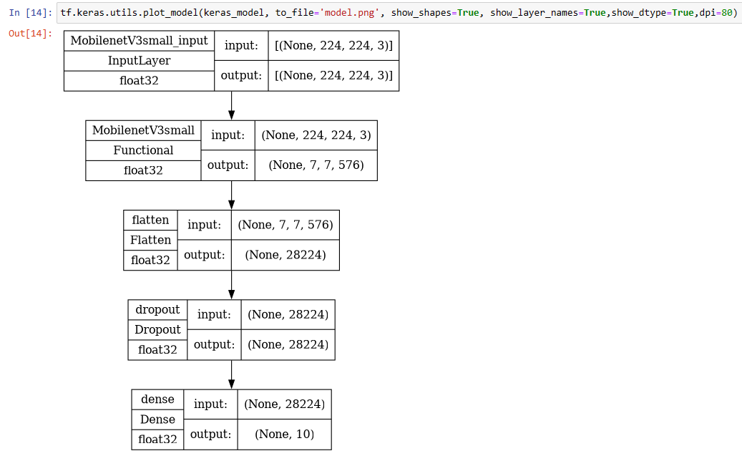
MobileNetV3Small Model

Slide 6
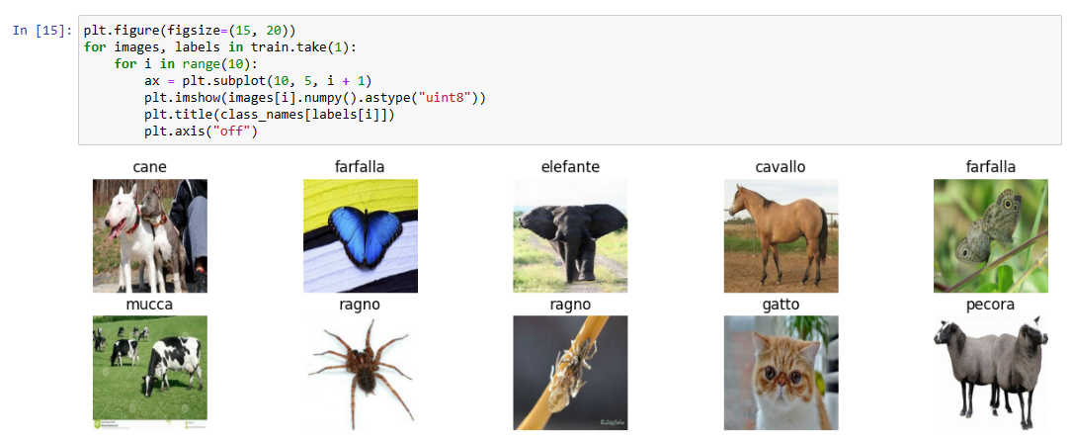

Slide 7
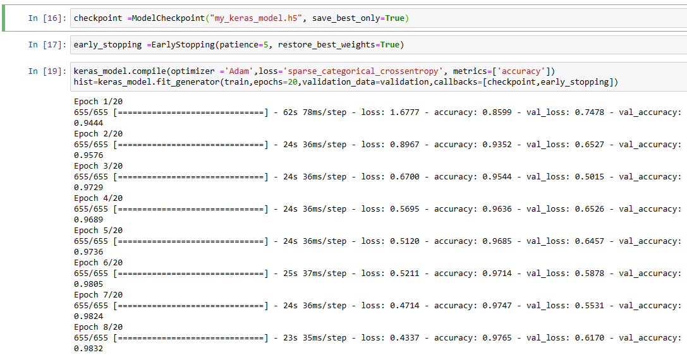

Slide 8
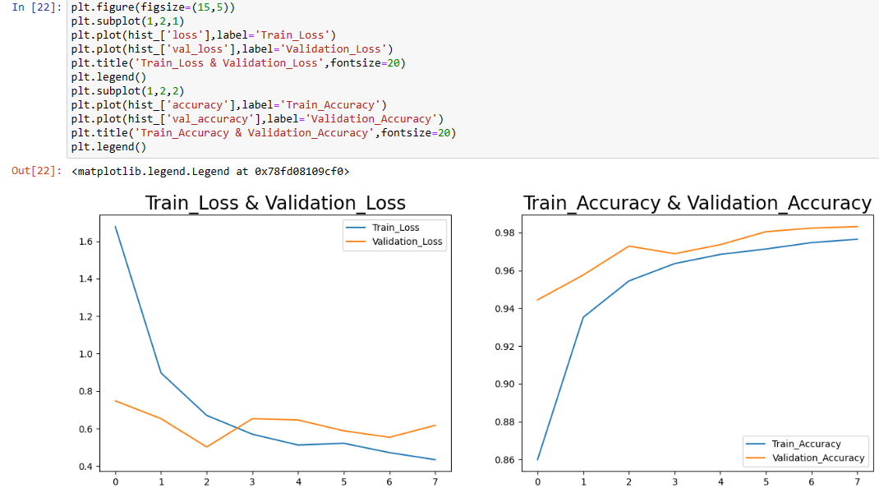
Histogram:

Slide 9
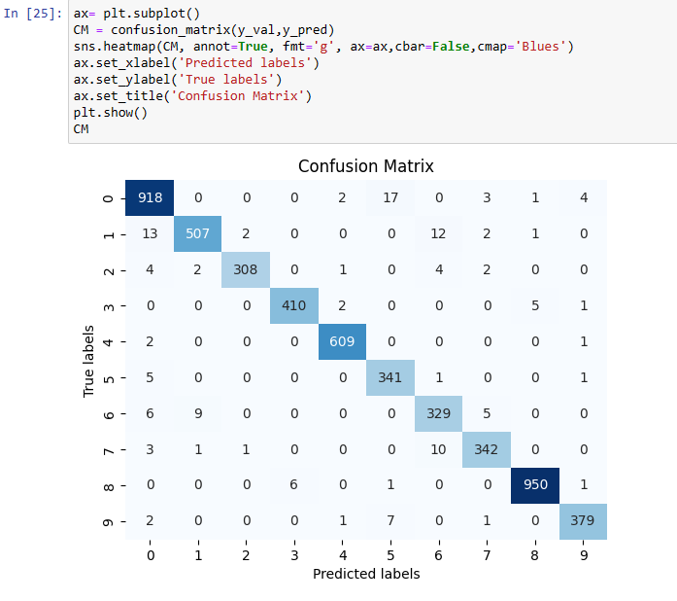

Histogram:

